Slide 1
Applied Statistics in Healthcare
Logistic Regression

Slide 2
Purposes in learning regression
Help make better decisions, faster, with an all-in-one approach.
Increase accuracy by controlling for other competing causes.
Save resources: Make better use of the data we already have. Advanced methods work well on small samples like aggregated data.
Develop an expertise in identifying trends: Knowing a regression trend line allows us to better interpret a standard report’s results.
Learn how to risk adjust and do predictive modeling.
Learn concepts that are the foundation of all other regression types.
Identify group trends useful in telling us if medical centers are improving, getting worse, and all on the path to reaching our goals.

Slide 3
Questions we can answer with Logistic Regression
In each question, we have an outcome with 2 options (e.g., readmission or not, alive or dead). And we have a factor that we want to know if different levels increase the chance for the outcome.
Is smoking linked to lung cancer?
Do older passengers have lower chances of surviving the Titanic?
Are men more likely to die 30 days after a heart attack?
Are men more likely to die 30 days after a heart attack, controlling for age?
Yes, smokers have significantly higher levels of lung cancer.
For every 1 year older, passengers have about a 1% less chance of survival.
Men are twice as likely to die than women.
Men are 1.5 times as likely to die than women after making all things equal on age.
We can even take into consideration multiple factors.

Slide 4
Session 1: Introduction to Logistic Regression
Background. Smoking and Lung Cancer

Slide 5
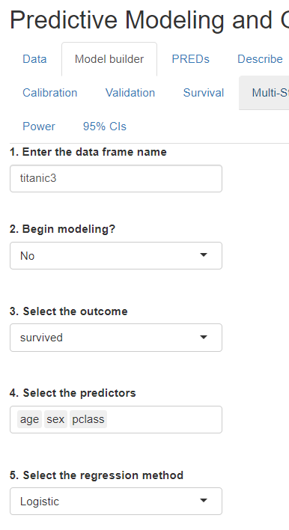
Syllabus
To use R data, you’ll need to install R (and R Studio to use the shiny app)
Session 1 (10/5 @ 2:00). Introduction to Logistic Regression [Slide 4]
Background: Logits, Odds Ratios, probabilities.
Hypothesis testing example: 1950 Doll & Hill study on lung cancer and smoking. Aggregated data.
Session 2 (10/12 @ 2:00). Diagnostic (or Explanatory) models, missing data, nonlinearity, and interactions. [Slide 57]
Case study 1: Major coronary disease.
Session 3 (10/19 @ 2:00). Prognostic (or Predictive) models, data reduction, and validation. Observed/Expected ratios and “Excess Deaths”. [Slide 73]
Case Study 2: 30-day mortality after an acute myocardial infarction (i.e., heart attack).
Session 4 (10/26 @ 2:00). Prognostic models. Implementing a model, selecting thresholds, decision analysis. [Slide 93]
Case Study 3: 30-day diabetes readmissions.
R: A file is provided that runs the models and creates some of the graphs, similar to what is found in this power point. Data is provided.
SAS: A SAS Regression program file is included on the final models and required data recoding. Data is provided.
If you would like to use my Shiny App, files found at:
https://github.com/szuniga07/rms
Shiny App

Slide 6
Topics and data
Interpretation of results
Variable importance
Partial predictions
Validation: Calibration & Discrimination
Nomograms
Working with predictions
Contrasts
Nonlinearity
Interactions
Excess deaths
Observed:Expected ratios
Hypothesis tests, Effect sizes, and predictive modeling
The 5 data file names:
dhlc = Doll & Hill Lung Cancer
acath2 = Significant Coronary disease
gusto2 = 30-day death after a heart attack
diab2 = 30-day readmission for diabetes patients
hyper = Hypertension

Slide 7
Multiple Logistic Regression
Regression: Regressing the outcome on one (simple) or more predictors (multiple).
Linear: It can refer to a trend line that best represents the relationship between the outcome and the predictor (Y ~ X) or 2) the additive nature of regression models (e.g., Y= X1 + X2 instead of Y= X1 * X2).
Outcomes: In logistic regression, the outcomes are 0 and 1. In ordinary least squares (i.e., “multiple linear regression”), the outcome has many more values (e.g., 0 – 1000).
Logistic regression is analogous to what is commonly referred to as linear regression (or Ordinary Least Squares) but for 2-category (or binary) outcomes. We’ll draw on comparisons between the 2 and use OLS notes and videos to provide more detail on concepts.
If you are familiar with multiple linear regression, Logistic regression is essentially the same idea. The rules are identical on the right hand of “=“, we have special considerations on the left side of “=“, e.g.,
Readmission = Age + Gender + Diagnosis

Slide 8
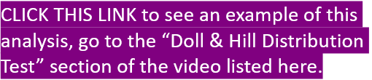
Statistical concepts discussed in the “Intro to Statistics” videos
Week 3
Week 4
Confidence Interval Background
22:52 - 24:45
95% Confidence Interval Example: Titanic passenger class
27:36 - 33:05
https://youtu.be/IQOoMmCQAD0
Statistical Significance
4:40 - 14:14
Doll & Hill Distribution Test
49:45 - 54:50
https://youtu.be/_BtABZd0Qok
Look for purple “Click this Link” boxes to come back here to find the time and Youtube link to our past courses. Session material is also found in the “Files” of this Team.

Slide 9
Methodological issues covered in the Multiple Linear Regression videos
Week 2
Week 3
Common issues and statistical solutions (small samples, Collinearity, confounding, overfitting)
9:25 - 23:05
Variable selection
23:06 - 28:15
Missing data
40:25 - 45:54
Interactions
45:55 - 48:18
Nonlinearity
48:19 - End
https://www.youtube.com/watch?v=5Yq49-Q0qng
Weighted regression
1:27 - 16:59
Data reduction
21:15 - 31:55
Model validation
31:56 - 52:47
Decision Curve Analysis
59:55 – End
https://www.youtube.com/watch?v=mkQb6FroSz4
Week 5
Model Approximation
40:05 - 44:00
https://youtu.be/2YYBIRvZtYw

Slide 10
Three reasons for doing regressions
Hypothesis testing: “We expect the group that received the intervention will have a lower readmissions rate”, “we expect the period after the vaccine to have a lower mortality rate”, etc.
Effect size estimation: We may want to know how much an effect has on an outcome. For example, what percentage of readmissions is reduced by an intervention? What are the cost savings from an intervention program?
Predictive modeling: We create predicted scores for individuals to assign care. For example, we may try to predict a patient’s or group’s chance of survival, length of stay, a child’s lung capacity, etc.

Slide 11
What is Logistic Regression?
Logistic Regression is a method for estimating coefficients or parameters that describe the relationship between independent variables and dependent variables (or outcomes). Rather than assuming all patients have a greater chance of readmission, we can test if there is a difference based on age.
Logistic Regression is similar to Linear Regression.
How it differs is that logistic regression is a probability model. Because probabilities can be converted into odds, we also get Odds Ratios in our results.
We develop a conceptual model: For example, it may look like this:
Hospital readmission = Age + Sex + Primary Diagnosis
Some variables may increase our chances while others decrease it.

Slide 12
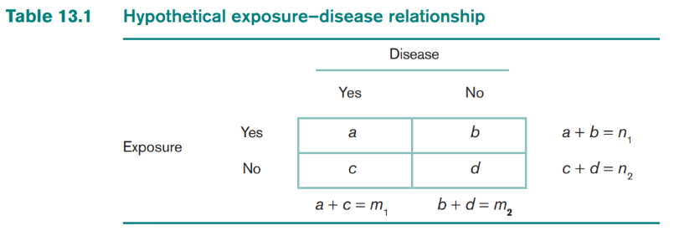
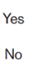
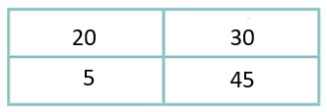
2 x 2 contingency tables
We often begin by summarizing our results in 2-by-2 tables.
For example, we may want to know if pneumonia (Exposure) patients have a higher chance of readmissions (Outcome). Our data: a=20, b=30, c=5, d=45.
We see more readmissions for pneumonia patients (20 vs. 5).
Readmission
or Outcome
Pneumonia

Slide 13
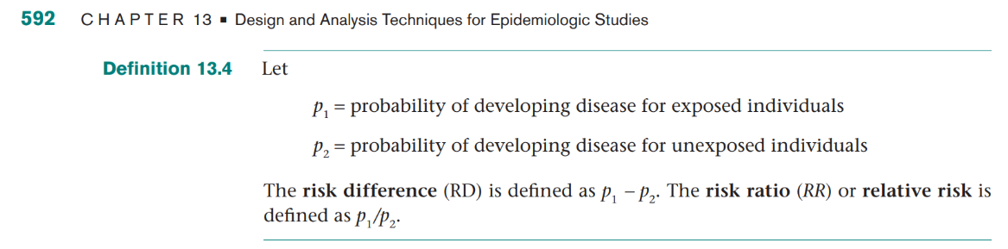
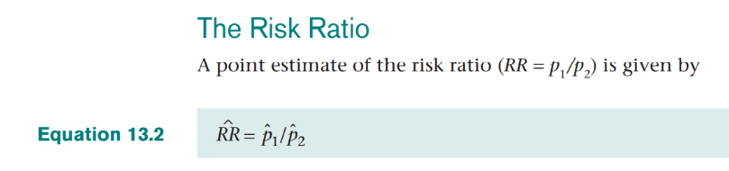
Working with probabilities from binary outcomes: Risk difference and Risk Ratios (or Relative Risk)
This slide points out there are other options but Odds Ratios are better.
These are commonly used statistics but we use Odds Ratios because of their more flexible statistical qualities.
For example, if P1= 0.0026 and P2= 0.007, then:
Risk Difference= 0.0026 - 0.007 =0.0019
Risk Ratio = 3.7 (0.0026 / 0.007)

Slide 14
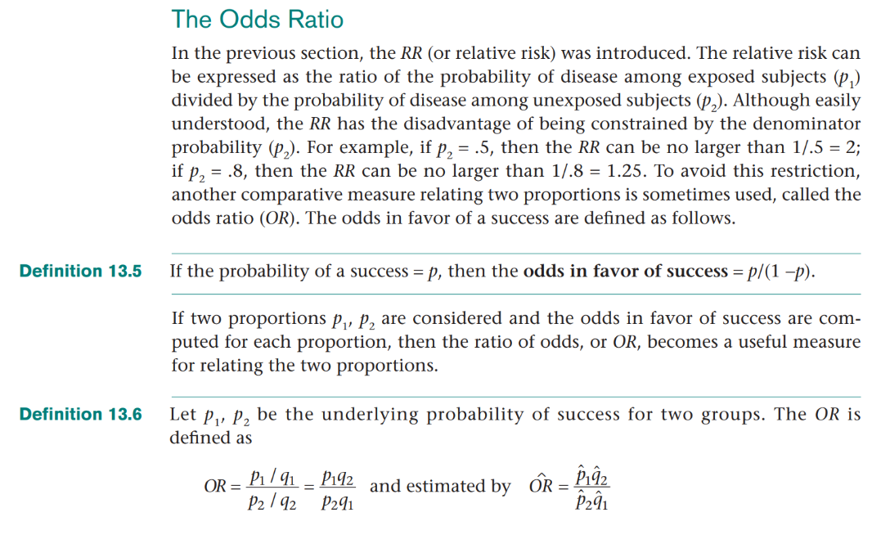
The Odds Ratio
The RR’s denominator range is limited so we use the Odds Ratio instead.
Do pneumonia patients have greater odds of readmission than non-pneumonia patients?
Odds PNA Readmit/
Odds non-PNA Readmit
= 2/1
We can convert probabilities into odds (e.g., 0.80/(1 – 0.80) = 4.
4/1 odds means of 5 people, 4=Yes, 1=No.
The Odds Ratio is calculated as the: Odds 1/ Odds 2.
p= Probability of A
q= Probability of not A

Slide 15
Various Odds Ratio calculations for the exposure (or factor)
We can use proportions, whole numbers, and multiplication to get the same odds ratio. See data table below.
Ex. 1 Proportions: [(20/ (20+30) ) / (30/ (20+30))] / [(5/ (5+45)) / (45/(5+45))]
Odds Ratio = (0.4/0.6) / (0.1/0.9) = 0.66 / 0.11 = 6
Ex. 2 Whole Numbers: Odds Ratio = (20/30) / (5/45) = 6
Ex. 3 Multiplication: Odds Ratio = a*d/b*c = 20*45 / 30*5 = 6
All 3 gives us the Odds Ratio of a readmission for those with pneumonia compared to non-pneumonia. For example, if we expect pneumonia patients to have
higher chances for pneumonia, then we expect that the
Odds Ratio of 20/30 and 5/45 to be > 1 (which it is).
This slide emphasizes that proportions/probabilities and whole numbers are related. They both give us odds ratios.
Readmission
Pneumonia

Slide 16
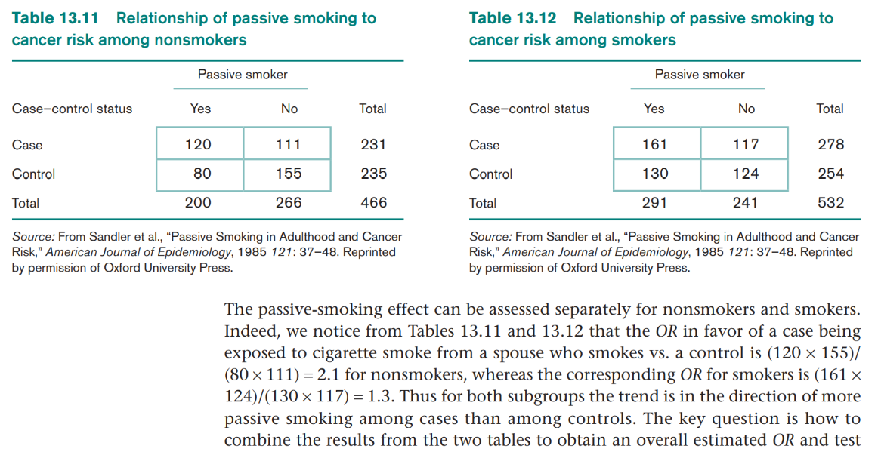
Odds Ratio example on passive smoking (2nd hand smoke) and lung cancer (= “Case”)
They are active smokers and passive smokers
Lung cancer
Alt formula: OR =(120/111) / (80/155) = 2.1
The Odds Ratio of “Passive Smokers with lung cancer” to “Passive Smokers without lung cancer” is 2.1. PS (non-smokers) are twice as likely to have lung cancer .

Slide 17
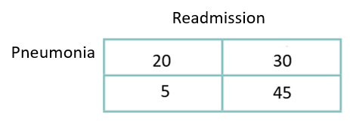
Distribution tests for binary outcomes (0 or 1, yes or no)
This slide emphasizes that there are different options for analyzing data like this.
We naturally want to know if an odds ratio indicates a significant difference (not happening by chance) between groups.
The Mantel-Haenszel or Binomial Proportion tests work.
The Chi-square test is another option that uses the values from our 2-by-2 contingency table. It is for binary outcomes with 2+ exposures/ factor levels. All 3 tests use the X2 test statistic.
For example in the table below, there is significantly higher readmissions for pneumonia cases (X2 = 10.453, p-value = 0.0012).
CLICK THIS LINK to learn more about “Statistical Significance” from the course video.

Slide 18
Why do we use Logistic Regression?
The Chi-square distribution test is limited in that it only tests association between 2 categorical variables. For example, we can’t assess the difference between readmissions and sex and age.
Logistic Regression allows us to control for multiple variables.
We may ask “can we use multiple linear regression instead”? We can’t because it can give us values that don’t make sense when our overall outcome rate is close to 0 or 1 (e.g., it might predict -0.10 readmissions for some groups or patients 65+ will have 1.31 readmissions when they can have at most 1 readmission). Readmission is coded as 0 or 1, not outside of that range. We can’t do a linear model directly on probability.
Sometimes linear regression gives impossible results for continuous predictors such as predicted ages of 130 years old.

Slide 19
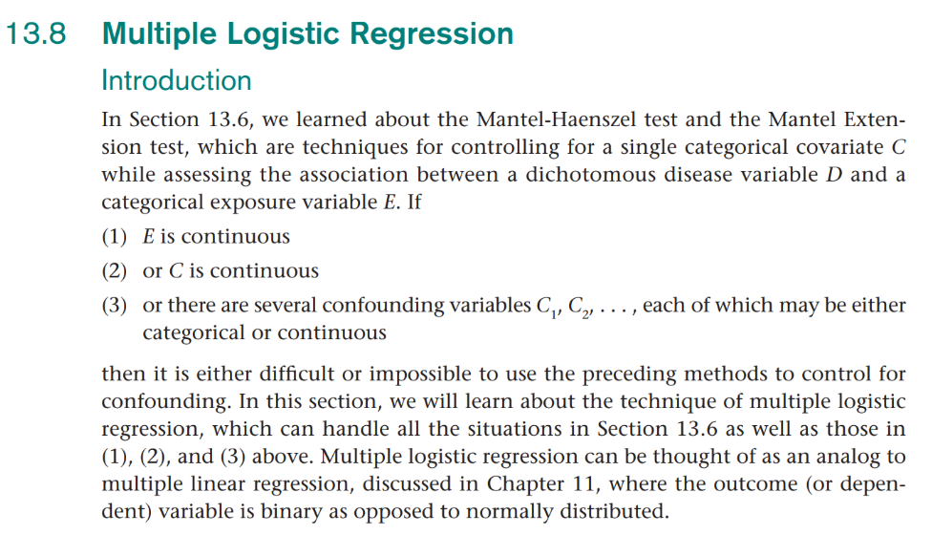
Logistic Regression
Common binary (or 2-level outcomes):
Death, Readmission, Infection, Heart Disease, Cancer, Missed appointment, etc.
This slide restates what we covered in the previous slide.

Slide 20
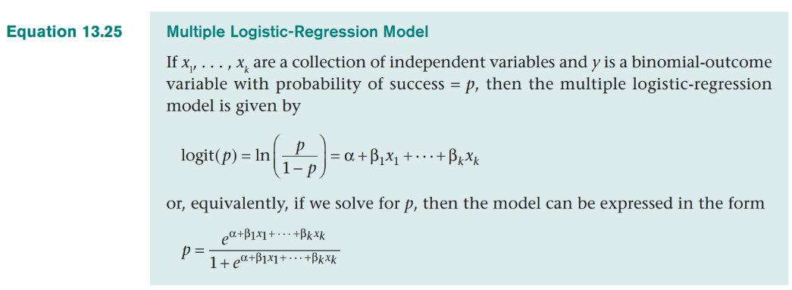
Logistic Regression is a probability model
The left side of “=“ is the transformed probability.
Everything on the right side of “=“ are the predictor (or independent) variables.
Because of the mathematical correspondence of 1) logits, 2) odds ratios, and 3) probabilities, we get 3 types of results.
Hospital readmission = Age + Sex + Primary Diagnosis

Slide 21
What do we get from a logistic regression?
Logits, Odds Ratios, and Probabilities.
Logits or natural logs: They allow us to have a linear additive model similar to multiple linear regression. For example, we can multiply the weighted regression coefficient by patients variable values and add them together to figure out a patient’s risk of death based on:
Age + Sex + Primary Diagnosis.
Odds Ratios: We can exponentiate our log odds values to let us know the odds in favor of death are 2 times higher for men than women. These are most helpful in explaining the results of each predictor.
Probabilities: We can sum our risk and determine that men have a 0.20 (or 20%) risk of readmission. These are most helpful in summarizing total risk.

Slide 22
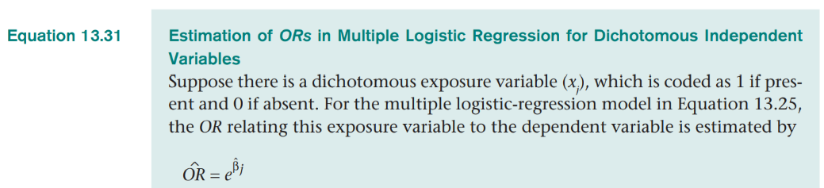
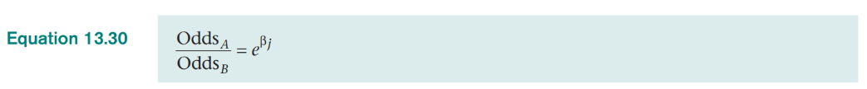
Logistic Regression gives us Odds Ratios
The eBj means we exponentiate the sum of logits for all variables.
This slide emphasizes that Odds Ratios can be calculated from exponentiated logits, eBj

Slide 23
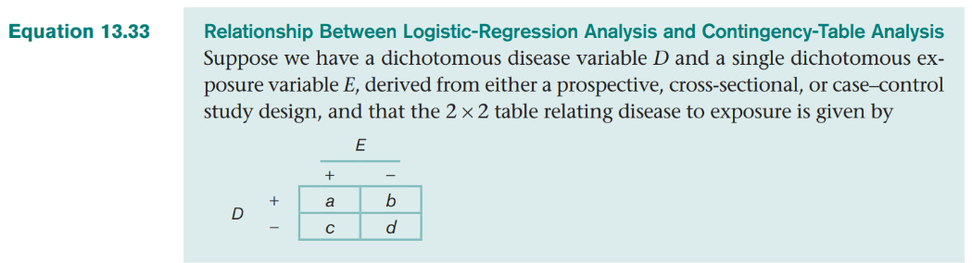
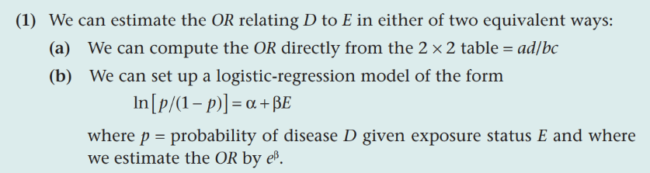
Relationship between Logistic Regression and 2-by-2 contingency tables
This slide emphasizes the relationship between Odds Ratios, probabilities, and exponentiated logits

Slide 24
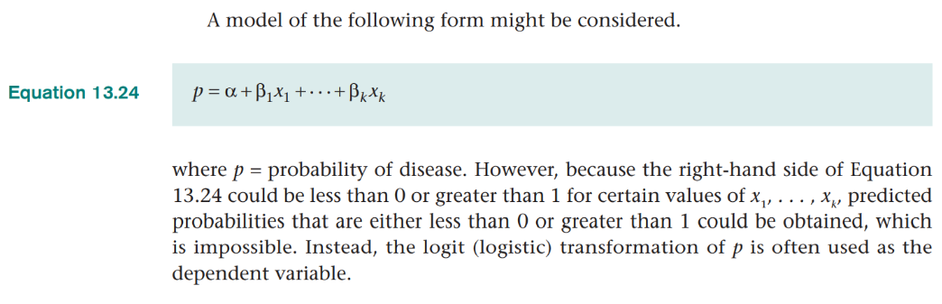
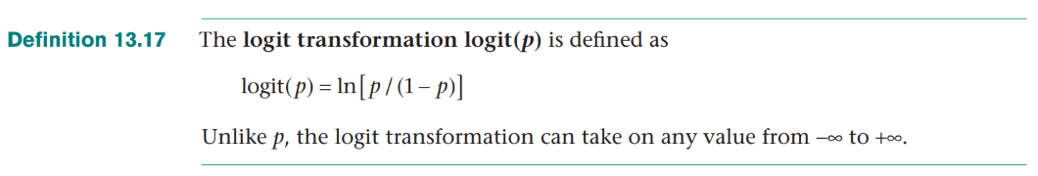
We can’t use probability as an outcome in Linear Regression so we use Logistic Regression instead.
This slide emphasizes that linear regression won’t work for binary outcomes.

Slide 25
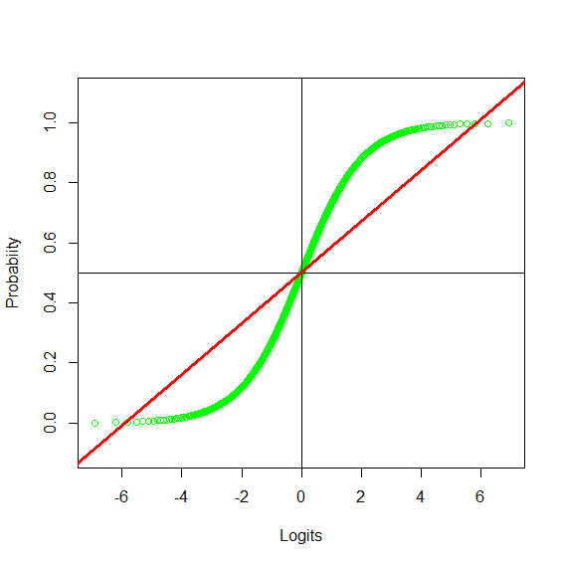
Relationship between Logits and probabilities
In this example, 0 = Alive, 1= Dead
Logistic Regression allows us to get linear trends that stay within probabilities of 0-to-1.
The green line represents logits that are properly constrained within 0 and 1. Notice extreme values on both ends get pulled in.
Using logit transformations solves the dilemma of getting credible estimated values from a regression.
The red line represents values that are not constrained and they can exceed the true limits of 0 and 1 in multiple linear regression.

Slide 26
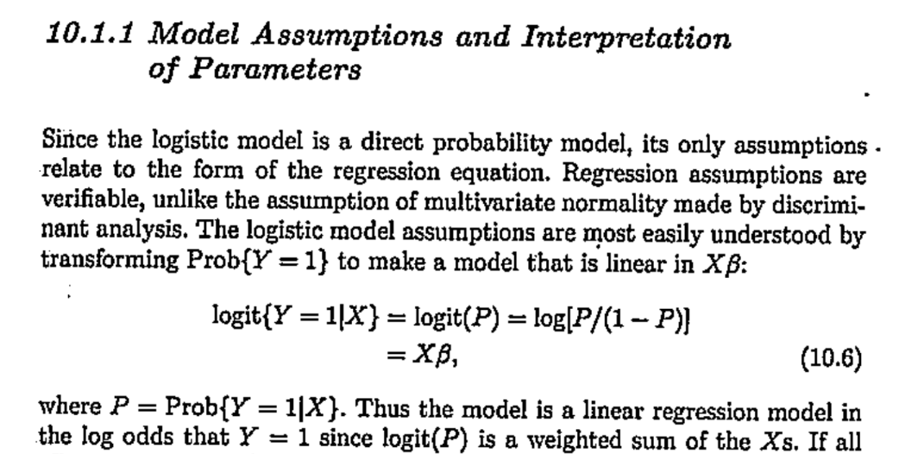
Logistic Regression Assumptions (Harrell, p. 221)
Unlike multiple linear regression assumptions, the logistic regression assumptions of 1) linearity & 2) additivity are verifiable.
Logits provide linearity & the additivity assumption can be relaxed by using interactions when appropriate.
This slide points out only 2 logistic regression assumptions & they are verifiable.
Harrell book

Slide 27
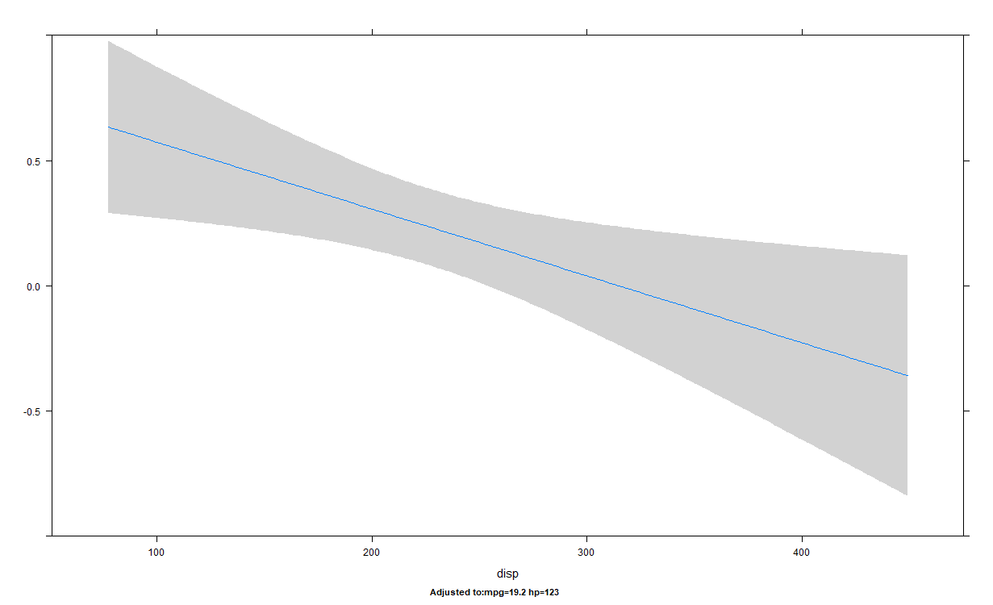
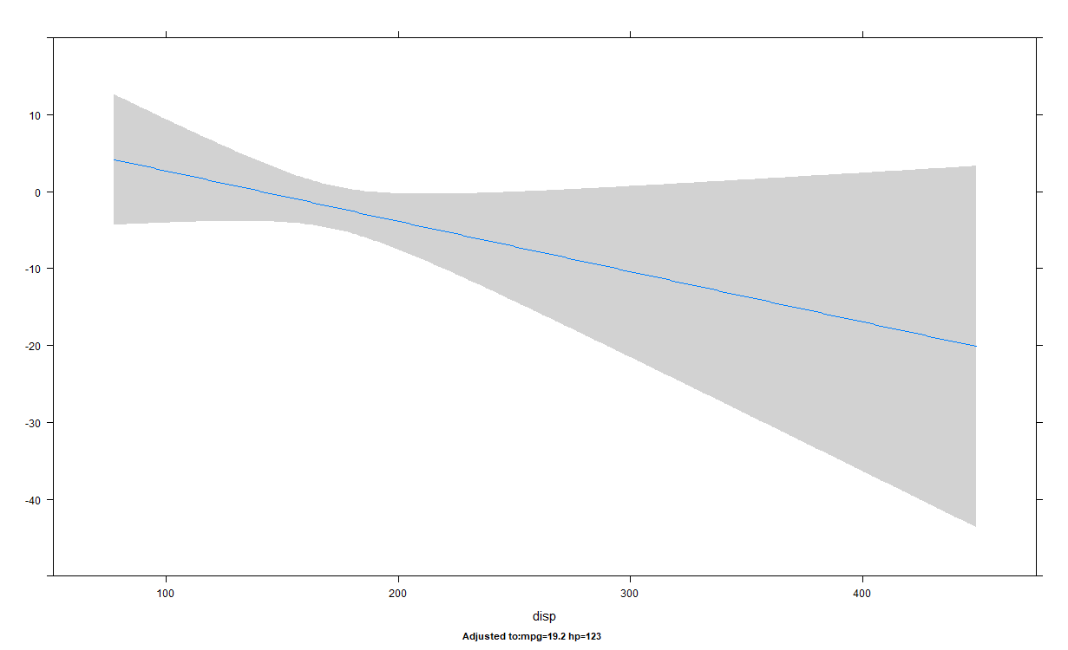
How logistic models improve our analysis: Comparison of predicted trends on binary (0/1) outcomes for linear and logistic regression (Automatic transmission (0/1) ~ engine displacement)
Multiple linear regression
Logistic regression
The lowest logit of -40 is converted into a probability slightly above 0.0. Logistic regression produces sensible values.
0.0 (manual transmission) is the lowest value possible.
Produces impossible predictions of -0.5. Linear regression designed to work on outcomes beyond the range of 0-to-1.

Slide 28
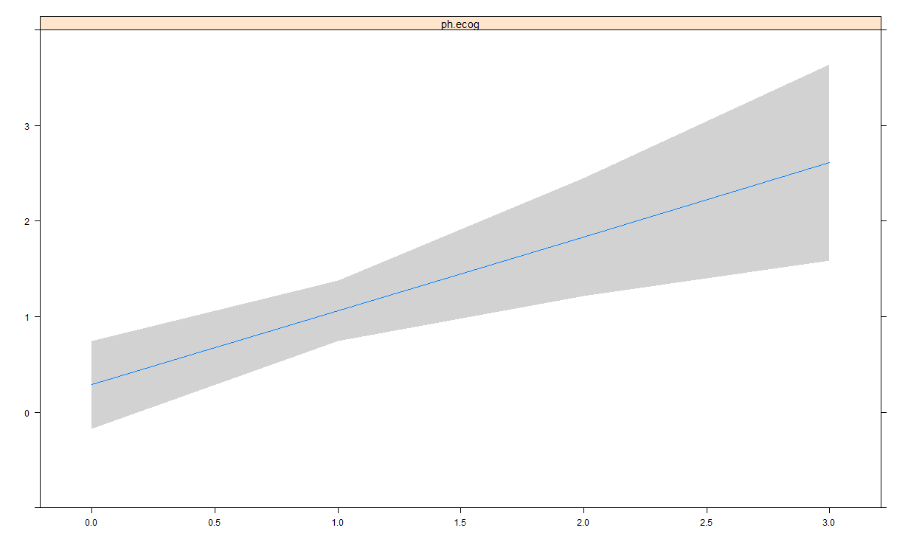
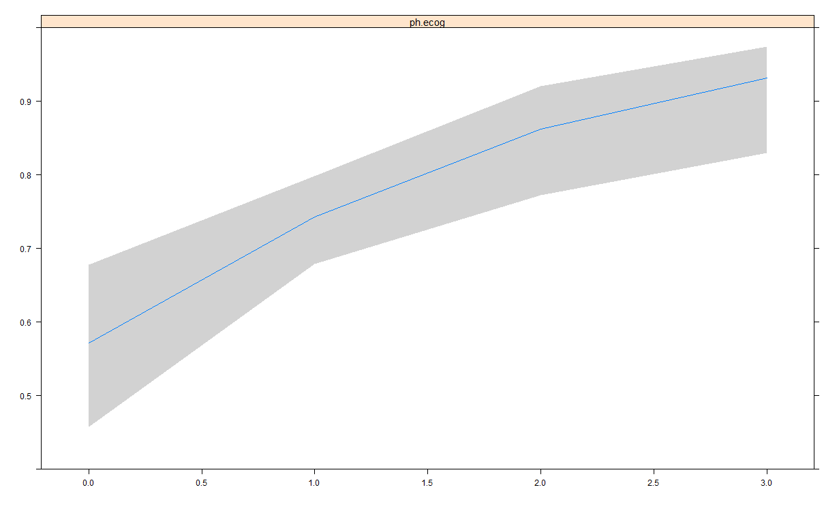
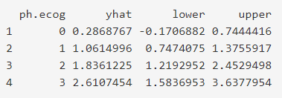
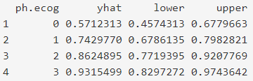
Partial prediction plot of the outcome predicted by age for log (we get logits and probabilities)
Log odds is linear (logit scale)
Probability is nonlinear (probability scale)
This line properly bends.
Logits range from -Infinity to +Infinity so the trend line can be flat.
Probability has a min. of 0 and a max. of 1 so the trend line naturally bends.
Logits let us think of linear trends between predictors and outcomes needed for regression.

Slide 29
Formulas that convert values between logits, natural logs, odds ratios and probabilities
p = Probability (e.g., Infections= 1/10 = 0.1)
exp = exponential
log = Natural Log
Odds = p/(1 - p) = 0.1/(1- 0.9) = 0.1111
Odds Ratio = Odds A / Odds B = 0.1111 / 0.250 = 0.44
Logit = logit(.1) = log(p/(1 - p)) = -2.197225
Log Odds = log(p/(1 - p)) = log(0.1/ (1- 0.1)) = -2.197225
Odds or Odds Ratio = exp(log(odds)) = exp(-2.197225) = 0.1111
How to get the Probability from the natural logs of odds:
exp(log(Odds)) / (1 + exp(log(Odds))) =
exp(log(0.1/ (1- 0.1))) / (1 + exp(log(0.1/ (1- 0.1)))) = 0.1
We don’t need to convert these numbers but it is helpful to know the different types of calculations and how they are related.
What we use most often from regression results

Slide 30
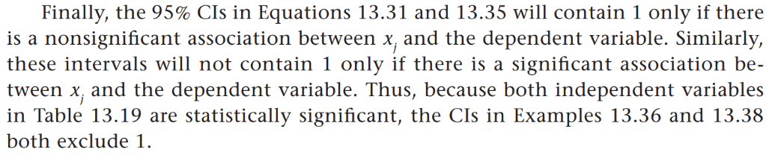
General rules on Logits, Odds Ratios, and Probabilities of independent variables.
Logits: Values > 0 indicate an increased chance of the outcome. Values below 0 indicate a decreased chance. 0 = no difference or a flat trend.
Odds Ratios: Values > 1 indicate an increased chance of the outcome. Values < 1 indicate a decreased chance. 1 = no difference or a flat trend.
Probabilities: Predicted Probabilities above (or below) the mean suggests an above (or below) average risk.
95% confidence intervals determine if the above values are significant.
CLICK THIS LINK to learn more about “Confidence Intervals”

Slide 31
Example: Hypothesis testing in logistic regression
Doll & Hill study on Lung Cancer and Smoking (1950)
Lung.Cancer ~ Smoker + Male

Slide 32
Background
In 1950, Doll & Hill published a study on smoking and lung cancer.
Other studies during the same period showed links between smoking and lung cancer (e.g., Wynder & Graham, 1950).
Doll & Hill considered the “competing cause” of auto pollution as well as better lung cancer diagnosis for the increase in cancer cases.
Their chi-square tests and balanced study design showed powerful evidence of the link between smoking and lung cancer.
We’ll apply Simple and Multiple Logistic Regression to their main Table IV to test the hypothesis of no difference in lung cancer between smokers and non-smokers, H0: Smokers = Non-smokers.

Slide 33
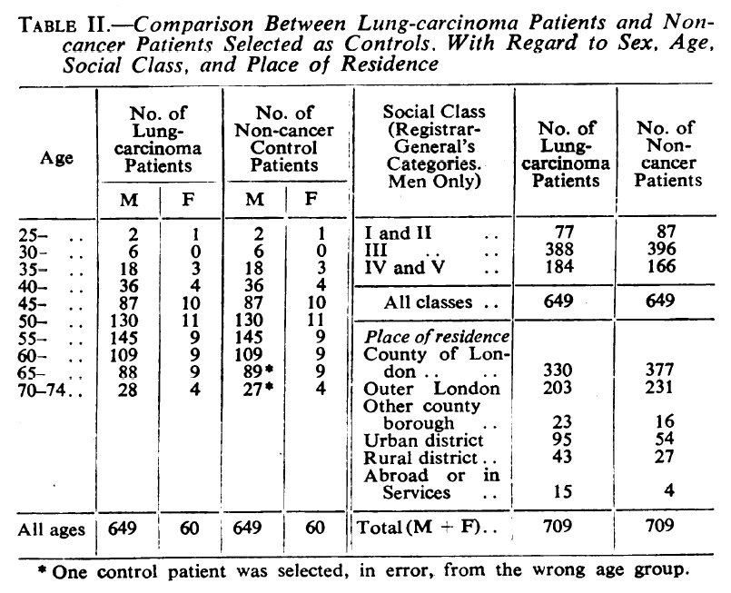
Patient information
Patients from twenty London hospitals were asked to participate in the study after being admitted for lung cancer or non-cancer diseases (controls).
Patients were balanced on age and sex for 709 cases with lung cancer and 709 without.
Logistic regression lets us balance mathematically when we can’t balance in our sampling.

Slide 34
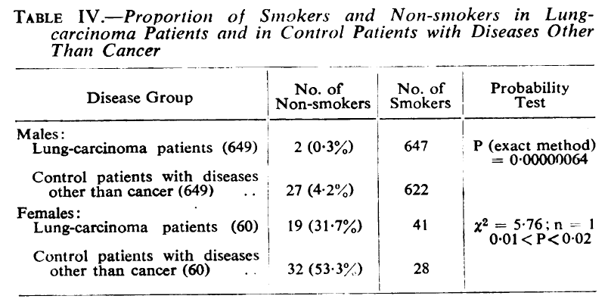
Higher rate of lung cancer for smokers (males or females)
The odds-ratio of smokers having lung cancer is:
688/650 (smoke & Cancer)
/
21/59 (Non-smoker & Cancer)
= 2.97
99.7% of males and 68.3% of females with lung cancer were smokers. Female non-smokers appear to have other sources of lung cancer (e.g., profession, 2nd-hand smoke or “passive smoking”—not asked about spouse’s habits, etc.)

Slide 35
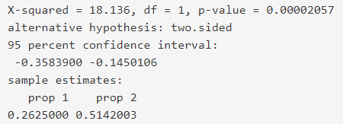
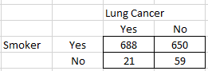
The results we get from a Binomial Proportion Test (same as a Chi-square test)
CLICK THIS LINK to see an example of this analysis, go to the “Doll & Hill Distribution Test” section of the video listed here.
This slide shows results as proportions (or probabilities) and odds ratios.
We might begin with a distribution test. Smokers have a higher rate of lung cancer than non-smokers
We can hand-calculate the odds-ratio from the data below. The odds in favor of lung cancer for Smokers over non-smokers is:
OR = (688/650) / (21/59) = 2.97
Smokers are 3 times (~200%) more likely to have Lung Cancer.

Slide 36
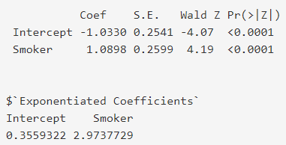
Using Logistic Regression
Below is the output from a simple logistic regression (1 predictor).
The tabled results in the top half have the natural logs of odds (1.0898).
The bottom half has the exponentiated Odds Ratios.
We see circled in red, the identical and significant Odds Ratio of 2.97.
The intercept represents the baseline risk for non-smokers. We can convert that value to a probability of 0.26.
Significant result (p < 0.05).
Logit coefficients
CLICK THIS LINK to learn more about “Statistical Significance”

Slide 37
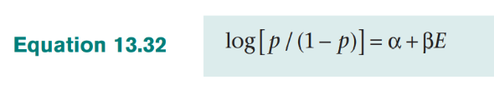
Adding a 2nd predictor
We want to control for differences between men and women.
We can’t add a 2nd predictor into a Chi-Square test so we use logistic regression.
Our conceptual model: Lung Cancer = Smoking + Male status
The logistic regression model:
Log(Odds)
Intercept (baseline, in all models)
Predictor variables

Slide 38
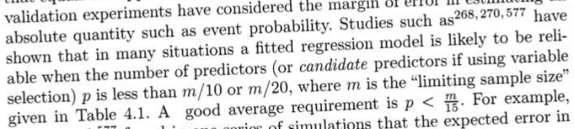
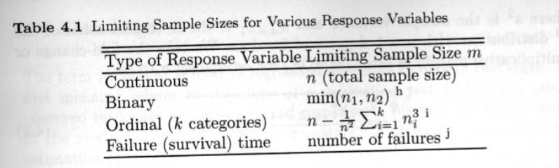
Rules on the number of predictors to use
E.g., lung cancer data, Cancer N = 709, 709/10 & 709/20 = up to 35 degrees of freedom. Harrell prefers M/15 = predictors.
Generally, max # of predictors should be about 20 to limit chances of overfitting.
A continuous or binary predictor has 1 d.f. while categorical predictors have # of categories -1 d.f. (e.g., high/medium/low =2 d.f.. Nonlinear terms increases d.f.
m = smaller of 2 binary levels
Harrell prefers m/15 = predictors
CLICK THIS LINK to learn more about “Variable Selection”
p. 72-73 of Harrell

Slide 39
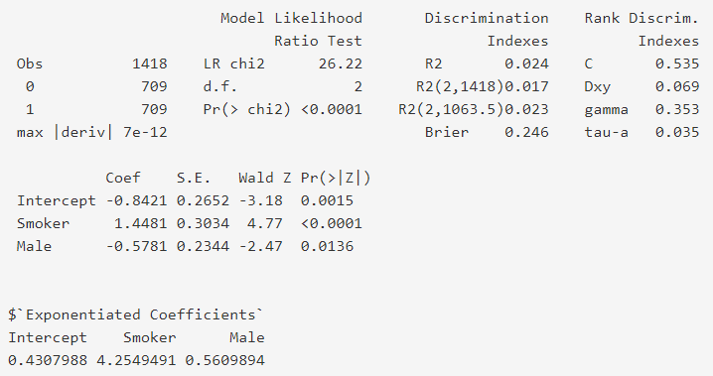
Multiple logistic regression model
The results show that being male is associated with a lower risk of lung cancer.
It is important to note that the researchers didn’t take into account if females were passive-smokers (i.e., females may have been exposed to 2nd-hand smoke).
The area under the curve (AUC) or Concordance-Statistic lets us assess our model performance.
0.54 is too low to be adequate for individual predictions but it is sufficient to test a hypothesis.
Standard errors help us define a normal range and the inverse, the significant values.

Slide 40
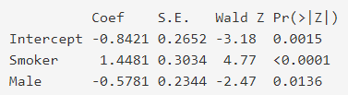
Interpreting coefficient results from logits
Smoker = 1.45. Because the logit is above 0, we know there is a greater chance of lung cancer for smoker’s than non-smokers while controlling for Male gender.
Male = -0.58. The logit is a negative value which indicates that men may have a lower risk of lung cancer when controlling for smoking status.
Intercept = -0.84. This indicates the baseline risk and is the value for female non-smokers. This low coefficient indicates that these patients have a generally low (but not the lowest risk).
Because Smoker and Male status are coded as 0 (“not present”) or 1 (“present”), it represents a change in logits for lung cancer. Here being a smoker increase the logits while being male decreases the logits.
Coefficients indicate a change in the outcome due to a 1-unit increase in the predictor. Here Smoker and Male only range from 0-1

Slide 41
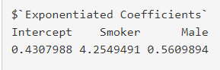
Interpreting coefficient results from odd ratios (are positive values)
Smoker = 4.25. Because the odds ratio is above 1, we know there is a greater chance of lung cancer for smoker’s than non-smokers while controlling for Male gender. The odds in favor of lung cancer are 4.25 times higher for smokers than non-smokers while controlling for gender.
Male = 0.56. The odds ratio is < 1 which indicates that men may have a lower risk of lung cancer when controlling for smoking status. The odds in favor of lung cancer are 0.56 times (or 44% lower) for smokers than non-smokers while controlling for smoking.
Intercept = 0.43. Although not technically an odds ratio, we can still calculate the odds are 0.43 times (or 57% lower) for female non-smokers.
The formal interpretation of a single predictor includes how we control for the independent variables in the model (e.g., “…while controlling for smoking.”) However, it is ok to describe your results by only mentioning the single variable since it is implied that we control for other variables in a regression.

Slide 42
Interpreting statistical significance of coefficient’s p-values
Smoker = <0.0001. From the p-value column on the right, we know that this is a significant difference. In other words, we know there is less than a 5% chance (alpha= 0.05) of being wrong in stating there is a significantly higher chance of lung cancer for smokers.
Male = 0.014. This is significant at the p <0.05 level (p= probability of a Type-I error of stating something is significant when it is not).
Intercept = 0.0015. This is almost always significant because we are just trying to measure the baseline. In bigger models, the Intercept doesn’t always represent all predictors=0 (e.g., age = 0).
Standard Errors (SE) let us determine a normal range. Coef/SE = Z-statistic. If Z exceeds the “critical value”, we have a significant result.
CLICK THIS LINK to learn more about “Statistical Significance”.

Slide 43
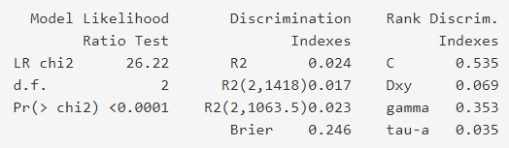
Interpreting model performance
There are various methods to assess model performance.
The most common method of assessing performance is through the Area Under the Curve (AUC) which is also referred to as the Concordance Statistic (C-stat).
Values range from 0.5 - 1.0. Values >= 0.70 are considered good but lower value may make models still useful (e.g., the C-stat of 0.535 is too low for individual predictions but are still valid for hypothesis testing).
The likelihood ratio test indicates if the model has some predictive power greater than chance.
R2 is the amount of variance explained, less useful in logistic b/c of binary outcomes.
AUC

Slide 44
Rules of thumb on AUC/C-statistic values for predictive models
Helpful to consider “how well can we predict an outcome?”. Much easier to predict lung cancer than hospital readmissions.
0.50 Equal to a random guess (ranges from 0.50-1.0, <0.50= backwards)
0.50 - 0.60 Poor (Hypothesis test results still valid, just doesn’t explain it all)
0.60 - 0.70 Moderate (Models still useful, some outcomes are tough)
0.70 - 0.80 Good (We can begin to reliably predict individual outcomes)
0.80 - 0.90 Very good
0.90+ Excellent (Beware of results that are too high, is there overfitting?)
Lower AUC values that aren’t ideal for individual predictions, can work well for groups. For example, the widely used Framingham Heart Disease model has an AUC ~= 0.65. Some outcomes are difficult to predict so we use the best available option. We can still reliably use it for gender groups, disease groups, etc.

Slide 45
Calculating predictions from model output
Your software will produce the predictions for you but here is how it works.
We want to get predicted probabilities.
We multiply the coefficients by the patient values and sum the logits (patient values in red).
Adding logits: Intercept + Smoker + Male
Female Non-Smoker = -0.8421 + 1.4481*0 + -0.5781*0 = -0.84 = 0.30 (Prob.)
Female Smoker = -0.8421 + 1.4481*1 + -0.5781*0 = 0.61 = 0.65 (Prob.)
Male Non-Smoker = -0.8421 + 1.4481*0 + -0.5781*1 = -1.42 = 0.19 (Prob.)
Male Smoker = -0.8421 + 1.4481*1 + -0.5781*1 = 0.028 = 0.51 (Prob.)
The next slide shows how to get the probability values in green above.

Slide 46
Calculating probabilities from exponentiated logits
To calculate probabilities, we use exp(Logits) / (1 + exp(Logits)).
Female Non-Smoker = exp(-0.84) / (1 + exp(-0.84) ) = 0.30 (Prob.)
Female Smoker = exp(0.61) / (1 + exp(0.61) ) = 0.65 (Prob.)
Male Non-Smoker = exp(-1.42) / (1 + exp(-1.42) ) = 0.19 (Prob.)
Male Smoker = exp(0.028) / (1 + exp(0.028) ) = 1.03 / (1+ 1.03) = 0.51 (Prob.)
Surprisingly, female smokers (few in 1950) had the highest risk (0.65) but it may be impacted by being exposed to 2nd hand smoke by spouses. Both male and female smokers have “above average risk” (>0.50). The lung cancer rate in the sample is 0.50. If it was 0.60, then they would be below average.
We calculate odds ratios and then convert into probabilities.

Slide 47
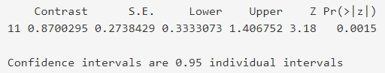
Calculating contrasts in predicted values
We can calculate differences in predicted values (p1 –p2).
Alternatively, we can do “contrasts” in the RMS package that tests if the difference is significant.
For example, below we see the contrast between male smokers and female non-smokers. The contrast is a logit = 0.87 (0.028 - -0.84) and the p-value = 0.0015.
Therefore, we know that the difference is significant.

Slide 48
Examples of R and SAS commands to run a logistic regression model
Standard R command:
glm(Lung.Cancer ~ Smoker + Male, data=dhlc, family = "binomial")
RMS package for R
lrm(Lung.Cancer ~ Smoker + Male, data=dhlc, x=TRUE, y=TRUE)
SAS command
proc logistic data = work.dhlc;
model LungCancer (event= '1') = Smoker Male;
output out = lc1 p = prob xbeta = logit;
run;

Slide 49
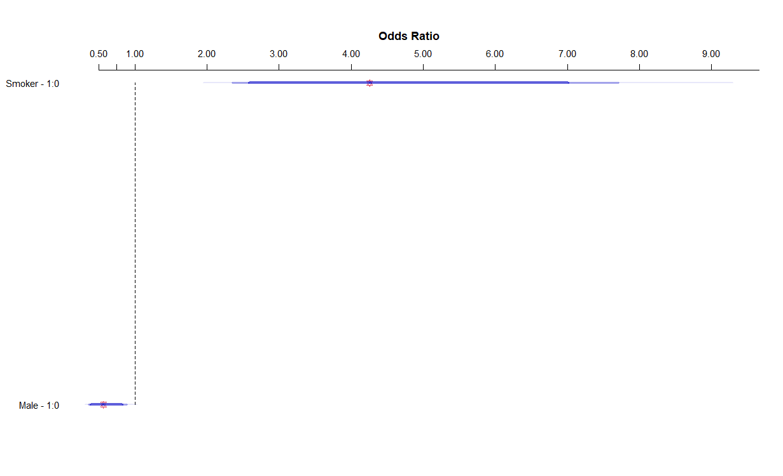
Effects above 1 indicate an increase in the outcome.
Effects below 1 indicate a decrease in the outcome.
Effects are significant when the blue confidence interval bar excludes 1. The blue bars are 90/95/99 confidence intervals.
These graphs make it easy to show that smoking greatly increases the odds of lung cancer. The blue bars of the 95% CIs show that the normal range goes from around 2.5 to 7.5 (i.e., in 95% of different samples, we are likely to see odds ratios within that range).

Slide 50
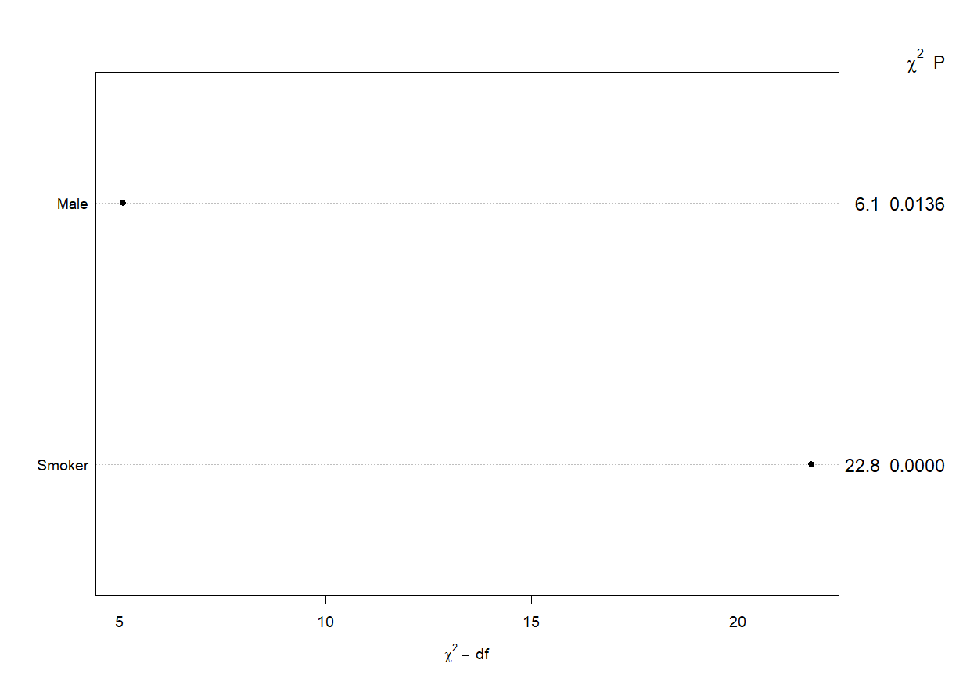
This is a variable importance plot that comes out of R. The p-values on the far right are from the output. The values to the left of it are the X2 (chi-square).
Roughly, the more important predictors have the higher X2.
The most important predictors of Y have dots furthest to the right. These give you the biggest bang for the buck.
“Most important” means that the predictor has the most impact on the outcome. If you improve this variable, you’ll see more improvement in the outcome than from the other predictors.

Slide 51
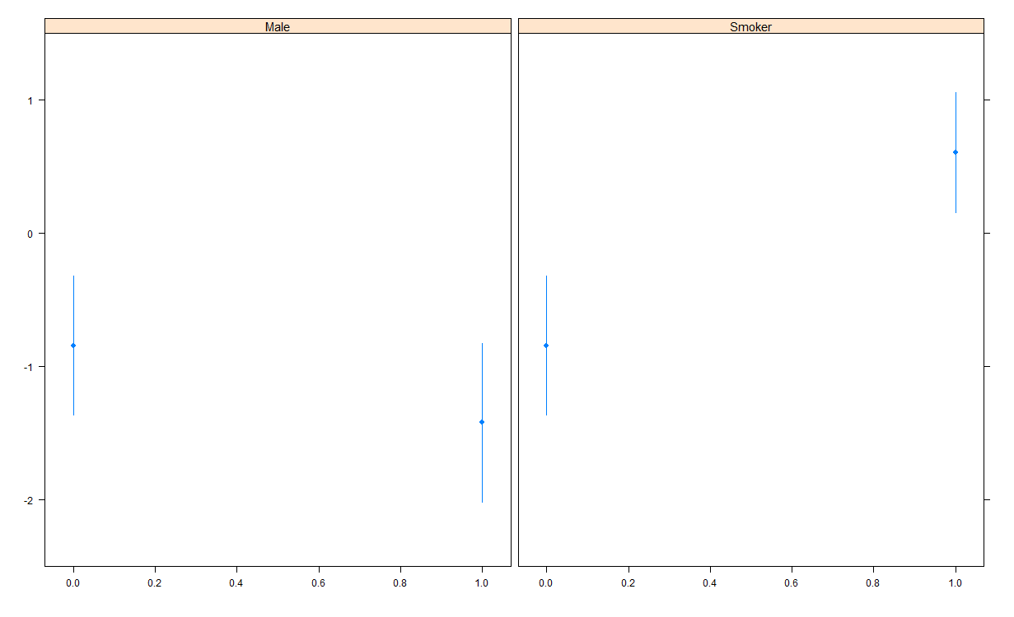
Partial prediction plots. This graphs the effect of each predictor while controlling for the other predictor
“The effect size while holding other predictors constant” or “controlling for other predictors” means we use the average for each predictor to calculate other predictor effects. For example, the partial prediction of lung cancer for Male = 1 and 0 uses the same other predictor values in the formula. Here we hold “Smoker” constant at 0 and use different values for “Male”:
-0.84 + (1.45*Smoker= 0) + (-0.59*Male= 0) = -0.84
-0.84 + (1.45*Smoker= 0) + (-0.59*Male= 1) = -1.43
These values are on the logit scale. Yhat = mean, “lower” and “upper” are where the blue bars end (normal range).

Slide 52
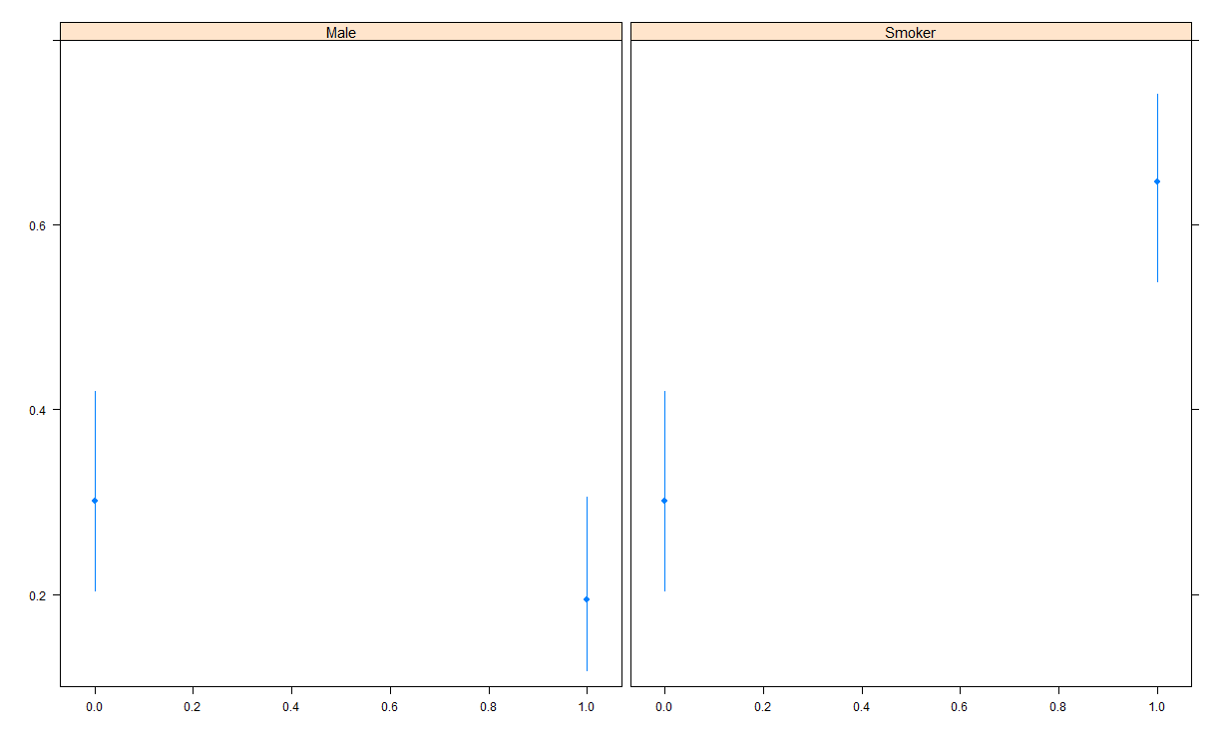
We can do the same type of partial prediction plots but using probabilities (proportions) on the Y scale.

Slide 53
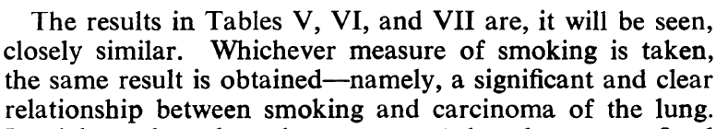
Summary
Doll & Hill’s Table IV shows a link between smoking and lung cancer.
The study design was carefully created and assessed. The authors clearly explained concerns of bias and sampling (e.g., interviewers and light smoking).
Results show a strong link between smoking and increased rates of lung cancer after ruling out other influences.

Slide 54
Using aggregated data in logistic regression
Weighted Logistic Regression (N = 8). Predicting Hypertension.
prop.hyp ~ smoking + obesity + snoring

Slide 55
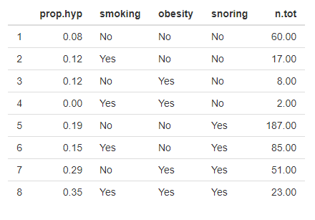
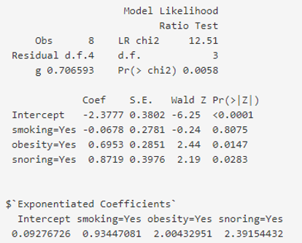
Logistic regression model aggregated data (n=8)
Data (N=8)
Weighted Logistic Regression
We can do a logistic regression on proportions by adding the variable “n.tot” (number of total rows) as a “weight” option (e.g., 60 rows have “No” as responses for the 3 variables)

Slide 56
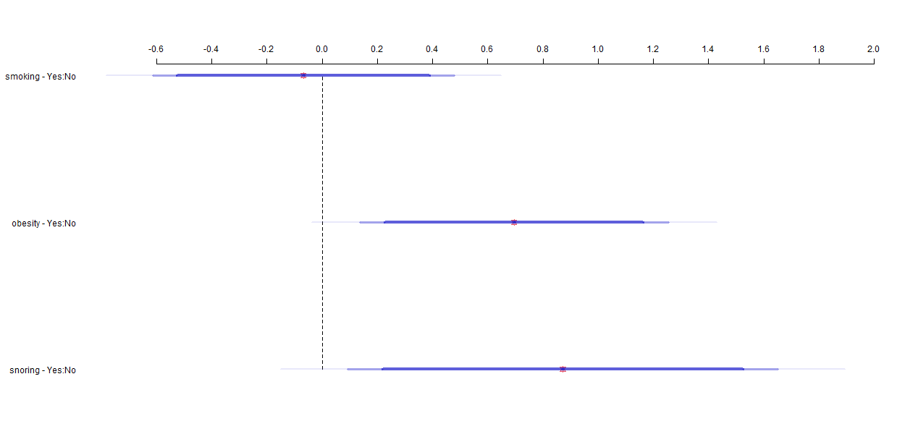
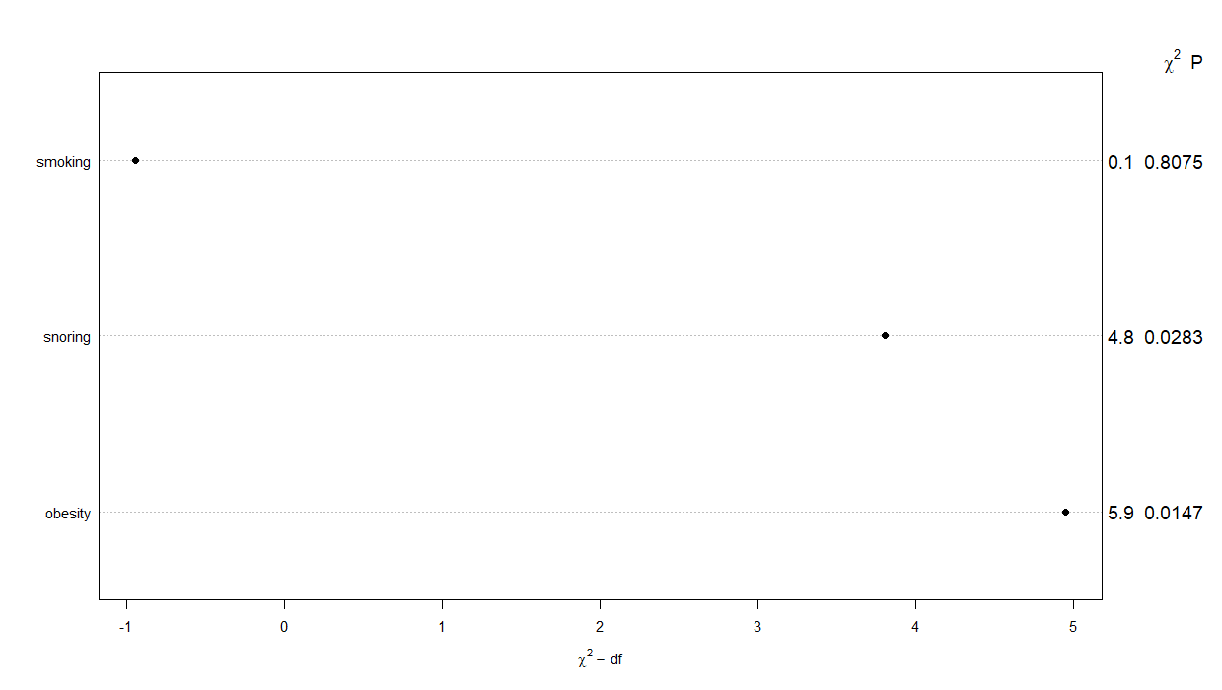
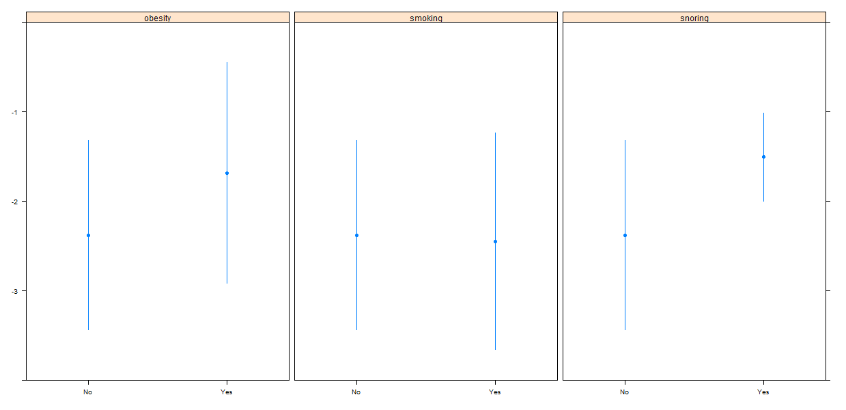
A weighted regression can be used to perform the same type of analyses and the same types of graphs.
CLICK THIS LINK to learn more about “Weighted Regression”

Slide 57
Session 2: Diagnostic modeling
Model Summary, nonlinearity, interactions, Variable Importance, Partial Prediction plots, Interactions, Calibration, 10-fold cross validation, Missing Data, Multiple Imputation, Nomogram

Slide 58
Significant Coronary Disease
Significant Dx = symptom duration + duration^2 + cholesterol + cholesterol^2 +
interaction of age*sex
sigdz ~ cad.dur + cad.dur2 + choleste + choleste2 + age * sex

Slide 59

Duke Cardiac Catheterization Coronary Artery Disease Diagnostic Dataset
https://hbiostat.org/data/repo/acath
https://hbiostat.org/data/repo/cacath
This dataset is from the Duke University Cardiovascular Disease Databank and consists of 3,504 patients and 6 variables. The patients were referred to Duke University Medical Center for chest pain. Some interesting analyses include predicting the probability of significant (>= 75% diameter narrowing in at least one important coronary artery) coronary disease. sex=0 for males, 1 for females.

Slide 60

Data Summary
Outcome. 66% rate.

Slide 61

Mean of Significant Coronary Disease for various variables by group categories or quartiles
Appears like a linear trend: Increasing rate with even spacing between quartiles
Male
Female
Appears like group differences: Males have a much higher rate than Females
Appears like nonlinear trends: Non-consistent increased rates for Symptom Duration and uneven spacing for Cholesterol

Slide 62

Model results
How to interpret interactions. The main effects (“age” and “sex”) represent a 1 unit increase when the other variable=0. We are most interested in the interaction variable “age.sex”. Here, it represents the difference in age trends between males and females.
Very good discrimination
The significant interaction and negative logits suggest that female (sex=1) trends have lower risks of significant coronary disease.
The significant squared terms for cad.dur2 and choleste2 suggest nonlinear trends. Cad.dur2 bends down and choleste2 goes up.

Slide 63

A 13 unit increase in age for males, results in increased odds of significant coronary disease by a factor of 3.
For duration of symptoms, we need to discuss both variables. Cad.dur increases the chances of Sig. Coronary disease but less so for higher duration in Cad.dur2
(i.e., “it increases at a decreasing rate”)
For cholesterol levels, we need to discuss both variables. Choleste2 increases the chances of Sig. Coronary disease, more so for higher levels.

Slide 64

Age is the most important predictor in understanding significant coronary disease in this data. Followed by the age*sex interaction.
In other words, if we only had the resources to select 1 variable to understand a patients chance of getting SCD, it would be age. That would give our staff a better chance of knowing who might have it and how we can plan to improve health outcomes.

Slide 65

Logits
CLICK THIS LINK to learn more about “Nonlinearity”
Using splines to show nonlinear trend
Using nonlinear splines to show trend

Slide 66

Probability
Using nonlinear splines to show trend.
Without high missing data, we might make “choleste2” & “choleste3” model because of 2 “bends”.
Using nonlinear splines to show trend

Slide 67

CLICK THIS LINK to learn more about “Interactions”
Males
Males have a significantly steeper increasing trend than Females.
This is a significant difference in trends between males and females.
Females

Slide 68

Model Calibration
CLICK THIS LINK to learn more about calibration in the “Model Validation” section
The average of the predicted values (X-axis) mostly matches the average of the actual outcomes (Y-axis). This shows a strong sign of calibration.
All 3 lines overlap, except at the lowest predicted values. Because most of the data are for high predictions (see upside down graph in the top right), we feel confident this model is useful.

Slide 69

Model Validation (10-fold cross-validation)
Convert to C-stat as 0.579/2 + 0.5
= 0.79
Primary validation statistics
Ideally,
Intercept = 0
Slope = 1
R2 is naturally low for binary outcomes
A 10-fold cross-validation, 1) breaks up the data into 10 equal samples, 2) holds out 1 sample as the testing set, 3) trains the model on the remaining 9 folds, 4) tests the model on the 10th fold, 5) cycles through each fold so that all will be the test set once, and 6) produces an average for the validity statistics.

Slide 70

All variables in the dataset where used to help impute the 1,246 missing values for Cholesterol.
Because 35% of the data is missing, I did 35 imputations.
Both the original and squared terms have a very high R2 (R2 > 0.99) because they are the same variable (e.g., inches to centimeters.
CLICK THIS LINK to learn more about “Missing Data”

Slide 71

Imputed model results
The imputed model performs as well as the non-imputed model. For simplicity of discussing with our audience, we may want to use the non-imputed model.
We don’t get model validation of imputed results. Remember multiple imputation provides coefficients that are the average from the 35 imputations.

Slide 72

Nomogram
Line up variable value with “Points” (50 years = 26 points).
The Nomogram lets us hand calculate predictions by adding up the points for each variable’s value and then sum the total to get the “Total Points” which correspond to a “Predicted Value”. Wider bars tend to be more important predictors.
For example, a 50 year old male, with CAD duration= 400, Cholesterol=200 has Total Points= 133. That gives him a Probability of 0.85 for Significant Coronary Disease.
To learn more about nomograms, go to 29:05 of https://youtu.be/dxwwbDUupts
Predicted Probability = 0.85

Slide 73
Session 3: Prognostic modeling
Model validation, Hierarchical Cluster Analysis, Model Approximation, Fast-backwards step-down regression, 10-fold cross validation, Observed/Expected ratios and “Excess Deaths”.

Slide 74
30-day death after a heart attack
Start with: DAY30 ~ SEX + AGE + KILLIP + SHO + DIA + HYP + HRT + ANT + HEI + PMI + WEI + HTN + SMK + LIP + PAN + FAM + STE + TTR
End with: DAY30 ~ SEX + AGE + KILLIP + DIA + HYP + HRT + ANT + PMI + WEI + TTR

Slide 75
Background
https://www.clinicalpredictionmodels.org/extra-material/exercises
The overall goal is to develop a regression model for 30-day mortality after an acute myocardial infarction.
785 patients, of whom 52 died (mean= 0.07)
A total of 20 predictors is considered. 18 were described in the papers by Lee et al and Califf et al.
Because there are 52 deaths and 733 that survived, we should consider the number of predictors. According to M/15 = 52/15 = 3.5, we may only want to use 4 predictors.

Slide 76
Variables
Name | Description (coding: no/yes is coded as 0/1)
DAY30 SEX AGE A65 KILLIP SHO DIA HYP HRT ANT PMI HEI WEI HTN SMK LIP PAN FAM STE ST4 TTR | 30‑day mortality (0/1) Female gender (0/1) Age in years (range: 19‑110) Age >65 years (0/1) Killip class: a measure for left ventricular function; class 1‑4 Shock: Killip class 3 or 4 vs 1 or 2 (0/1) Diabetes (0/1) Hypotension (systolic BP<100) (0/1) Heart rate (tachycardia: pulse>80) (0/1) Anterior infarct location (0/1) Previous myocardial infarction (0/1) Height in cm (range: 140‑212) Weight in kg (range: 36‑213) Hypertension history (0/1) Smoking (1=never; 2=ex; 3=current smoker) Lipids: hypercholesterolaemia (0/1) Previous angina pectoris (0/1) Family history of MI (0/1) ST elevation on ECG: number of leads (range: 0‑11) ST elevation on ECG: >4 leads (0/1) Time to relief of chest pain > 1 hour (0/1)

Slide 77

Data Summary of main predictors
Outcome. 6.6% rate.

Slide 78

Regression model output
The model performs well initially but we want to know how valid are the results (i.e., will it hold up over time)

Slide 79
Model Validation: Calibration and Discrimination
CLICK THIS LINK to learn more about “Model Validation”
Calibration: Models are calibrated to a dataset when the average of their predicted values matches the average of the actual outcomes. Models should be re-calibrated if the calibration weakens over time, especially if the model was developed outside of your organization (Morton, pp. 128-129).
Overall calibration error: Average of Y – Average of predictions. If using ordinary least squares, the calibration error = 0 in the original data.
A calibration curve can help visualize the calibration. We can select deciles or quintiles of the sample and plot the average outcome and predicted values in each group.
Discrimination: The extent to which a model predicts higher outcomes for those with higher outcomes. This is AUC and R2. We can also use MAD. This is an individual level summary.
“While good model calibration is desirable, discrimination is usually more important” (Iezzoni, p. 253).
For example, if the average length of stay is 3 days, a model that assigns predictions of 3 days to everyone is perfectly calibrated. But a model that assigns 3-day predictions to those who actually stay 3 days while just assigning 1-day predictions to those who stay only 1 day, that model provides more useful information.

Slide 80

Model Validation (Split-half)
Index.orig - Optimism = Index.corrected
Too much optimism
Training – Test = Optimism
Convert to C-stat as 0.314/2 + 0.5 = 0.66
We see a significant drop in performance after we validate
(0.84 vs. 0.66)
We may want to check if it was a “bad split” and try a new seed in the random number generator, etc., but we’ll try to trim our model instead. Model validation helps if you are new to the topic and not sure if all the variables are clinically relevant.

Slide 81

Methods such as Hierarchical Cluster Analysis can greatly improve model reliability because it reduces collinearity. However, there appears to be only pairs of variables that highly cluster together (i.e., not much benefit of making a composite variable from only 2 variables). Because of the poor model validation, we’ll eliminate multiple predictors instead.
CLICK THIS LINK to learn more about “Data Reduction”

Slide 82

We can reduce variables and maintain 95% of the predictive power of the gold standard model.
CLICK THIS LINK to learn more about “Model Approximation”

Slide 83

Variables we can delete without losing any substantial predictive power.

Slide 84

Another approach to data reduction is to use “Fast backwards step-down regression” (see Harrell book)
It uses AIC based suggestions on the far right. It suggests removal of predictors that don’t have a significant change in the AIC.
“AGE” and “HRT” are found to be the key predictors.
Because some of the removed predictors may be clinically relevant to my clients, I will consider both the model approximation and the step-down regression.
The 2 predictor model AUC/C-stat = 0.79 and validates at 0.78. This performs well.

Slide 85

Improved
model
AUC/C-stat are only 0.006 points lower in the new model

Slide 86

Model Validation (10-fold cross-validation)
Convert to C-stat as 0.576/2 + 0.5 = 0.79
The cross-validation appeared to provide more stable results. I compared 10 different random seeds and it was more stable with 10-fold than 2-fold. The sample size may have been too small for split-half.
Split-half C-stat= 0.79. Much better validated results than before.

Slide 87

Age, Heart Rate, Killip class, and time to relief of chest pain all increase a patient’s odds of 30-day mortality.
For example, going from a lower age of 43 (1st quartile) to 71 years (3rd quartile) represents about a 5-fold increase in the odds of death.

Slide 88

Variable Importance
As the “fast backwards step-down regression” suggested, AGE and HRT were the most important predictors

Slide 89

Partial Prediction plot using logits

Slide 90

Partial Prediction plot using probabilities
Notice the similar patterns with logits but how trends pull in towards 0 on the Y-axis.

Slide 91

Final model (reduced to 4 predictors based on 52 deaths/20 rule)
Validated AUC = 0.78
The validated model stays closer to the original AUC.
If more variables are considered key study questions, suggest doubling sample size to get the 10 predictor model.

Slide 92
Calculating Observed/Expected ratios and “Excess Deaths”
For our sample, we can calculate the total number of deaths by summing up all of the probabilities returned from our model (e.g., Patient 1 =0.02 + Patient 2 =0.09 + etc.).
For future samples, we do something similar, we calculate predictions from an existing model to determine the predicted deaths.
The Observed/Expected ratio from our sample is 52/52 =1.0. Because our model is based on our sample, O/E ratio = 1. Future data would differ.
Excess Death = Observed – Expected = 52 - 52 = 0.
If next year’s sample has 81 observed deaths and 78.7 Expected deaths: Observed/Expected ratio = 1.03 & Excess Deaths = 2.3.

Slide 93
Session 4: Prognostic modeling
Model Approximation, Selecting a model threshold to implement a model, decision curve analysis for clients

Slide 94
30-day readmissions
Diabetes patients

Slide 95
Model using all predictors
readmitted ~ race + gender + age + weight + admission_type_id + discharge_disposition_id + admission_source_id + time_in_hospital + payer_code + medical_specialty + num_lab_procedures + num_procedures + num_medications + number_outpatient + number_emergency + number_inpatient + number_diagnoses + max_glu_serum + diabetesMed + A1Cresult + metformin + repaglinide + nateglinide + chlorpropamide + glimepiride + acetohexamide + glipizide + glyburide + tolbutamide + pioglitazone + rosiglitazone + acarbose + miglitol + troglitazone + tolazamide + insulin + glyburide.metformin + glipizide.metformin + glimepiride.pioglitazone + metformin.rosiglitazone + metformin.pioglitazone
Final model
Readmit.30.Days ~ gender + diabetesMed + time_in_hospital + time_in_hospital2 +
number_diagnoses + number_diagnoses2 + number_inpatient + number_inpatient2 +
glyburide.metformin + weight + num_procedures + num_medications + insulin + metformin + number_emergency + age + payer_code + medical_specialty + discharge_disposition_id
HA1C Result not included in the final model because of low predictive power from a model approximation and a high number of missing values. We would definitely keep it in the model if our clients found it clinically relevant.

Slide 96
Background
https://archive.ics.uci.edu/dataset/34/diabetes
Data collected during 1998-2008, N = 101,766.
Number of predictors= 50.
Outcome= 30-day readmission (mean=0.11). Initial study to predict HA1C and readmission of diabetes patients. Demographics and pharmacy predictors included. Article found in “Files”.
30-day readmissions is traditionally a tough outcome to predict because of the numerous causes, data collection is not available beyond discharge, and it can look very differently between populations.
Presents the situation when high predictive validity is not possible.

Slide 97



All predictors
Because of the large sample sizes, models validate at the same level of the AUC (C statistic)
Some predictors (excludes pharmacy)
Model performance increased because low N categories of variables were recoded into larger groups
Approximated

Slide 98

Variable Importance
Not all predictors would be considered important

Slide 99

We can remove over 20 variables from the model and still have 95% of the predictive power of the full model (gold standard)

Slide 100

Model validation of final model
Convert to C-stat as 0.336/2 + 0.5
= 0.67

Slide 101

Variable Importance of the final model
Many variables have categories with a very low N such as “discharge_disposition_id”. It is unclear if this has categories that would make the variable look more important than it is such as a discharge disposition of death. Those have a 0.0 chance of readmission, AUC rewards predicting 0 as well as 1.

Slide 102

Putting the model into production
A traditional approach to setting a threshold is using the rate of 30-day readmissions. Here we select a probability of 0.109.
Our AUC or C-statistic is 0.63 which is close to the validated model of 0.67.

Slide 103

Considering another threshold
We can also set a more aggressive target. We select a probability of 0.083. Our AUC = 0.61.
We have improved our identification of patients that have a readmission but at the cost of having more False-Positives. We must consider how much catching a readmission is “worth it”.

Slide 104
Decision Curve Analysis: Considerations in predicting outcomes
Potential benefits: Predictive models and assessment scales can identify those likely or unlikely to have an extended length of stay, fall, 30-day readmission, etc.
Cost of interventions (time, money, quality of life, etc.): When deciding on using predictions or scales, we must consider how costly interventions are (e.g., 10% cutoff: “preventing 1 readmission is worth the cost of intervening on 9 patients who wouldn’t be readmitted”).
See Vickers, 2019.
CLICK THIS LINK to learn more about “Decision Curve Analysis”
Notes:
About 2/3s of falls happen are inpatient and about 1/3 in the ED.
There were about 107,000 and 121,000 admits or discharge (including observations) in SCAL for 2020 and 2021. KP Insight HUS report.
As an extreme example, suppose an event happens once a year in SCAL, any preventative efforts will reduce the event by a count of 1 using an excellent prediction model or assessment scale.
Hester-Davis was developed in the ER setting not the inpatient. Many fall studies show tools not working as well in different settings.

Slide 105
What is a Decision Curve Analysis? (see Vickers, 2019)
A decision analysis allows us to determine the optimal cutoff in which we intervene based on our predictive model or assessment scale.
For outcomes with high risk to life, we may set a lower cutoff. We may also set low cutoffs if the intervention costs are very minimal (i.e., we compare cost and benefit).
For rare events with expensive interventions, there can be more opportunity for savings by identifying those with low risks (e.g., falls) so we can avoid unnecessary interventions.
DAs can guide us in how we balance the costs for preventing an outcome compared to the cost of interventions for those who never would have the outcome (e.g., 1 readmission = 9 non-readmits) .

Slide 106


A net benefit of 0.0426 indicates that the difference between our true-positives and false-positives will be finding about 4 to 5 more true positives per 100 patients using a cutoff of Readmission = 0.083.
Using a cutoff of 0.109 yields a net benefit of .029.
The X-axis has the percentiles of the predicted scores (e.g., the dashed line ranges from the 5^{th -}95th percentiles).

Slide 107

These are interventions avoided. We can avoid about 13 of 100 unnecessary interventions with a threshold of 0.083. But we can avoid 21 of 100 interventions with a threshold of 0.109.
We need to weigh the cost/benefit of avoiding a readmission vs. the cost of the intervention. An automated call may have different considerations than a home care visit.
The reason we can avoid more interventions with a higher threshold is that the model has a high specificity level and the majority of patients won’t have a predicted probability over the threshold.

Slide 108

This plot shows the True-Positives (Sensitivity) on the same scale (see Y-axis).
We can see there are far more patients that don’t have a readmission.

Slide 109
Appendix
Types OF STUDIES, 1- AND 2-TAILED HYPOTHESIS TESTS, COUNFOUNDING, MODEL VALIDATION, MODEL COMPARISON, AND REGRESSION STRATEGIES

Slide 110

Different types of studies (Rosner book)
Logistic regression can be applied to all of these types of studies.

Slide 111

One- and Two-tailed tests
We almost always do a two-tailed test in which we test for significance in both directions (e.g., we test if age is associated with a greater or lower risk of readmissions).
On rare occasions, we may test if a predictor variable is associated with an outcome in a specific direction (e.g., Intervention A lowers the risk of readmissions). This one-tailed test requires a lower “critical value” to show significance (i.e., easier to get).
However, in health care we generally don’t use it because we usually don’t have strong support in the literature, high patient risk, and high samples sizes that already make p-values smaller. Use cautiously.

Slide 112

Confounders

Slide 113
Model Validation: Calibration and Discrimination
Calibration: Models are calibrated to a dataset when the average of their predicted values matches the average of the actual outcomes. Models should be re-calibrated if the calibration weakens over time, especially if the model was developed outside of your organization (Morton, pp. 128-129).
Overall calibration error: Average of Y – Average of predictions. If using ordinary least squares, the calibration error = 0 in the original data.
A calibration curve can help visualize the calibration. We can select deciles or quintiles of the sample and plot the average outcome and predicted values in each group.
Discrimination: The extent to which a model predicts higher outcomes for those with higher outcomes. This is R2. We can also use MAD. This is an individual level summary.
“While good model calibration is desirable, discrimination is usually more important” (Iezzoni, p. 253).
For example, if the average length of stay is 3 days, a model that assigns predictions of 3 days to everyone is perfectly calibrated. But a model that assigns 3-day predictions to those who actually stay 3 days while just assigning 1-day predictions to those who stay only 1 day, that model provides more useful information.

Slide 114
Discrimination
Discrimination is the model’s ability to separate subjects’ outcomes.
The worth of a model can be judged by how far it goes out on a limb while still maintaining good calibration.
If one model assigns 2% of the sample to a risk of dying above a predicted value of 0.90 while the other model assigns 8% of the sample to the same high-risk group, the second model is more discriminating.
Discrimination is assessed with R2. A primary interest is comparing the R2 in the training and test sets, a large drop in R2 in the test set indicates overfitting.

Slide 115
Comparing two models
Frequently one wants to choose between two competing models on the basis of a common set of observations.
In this case, the predicted values calculated from the training set results can usually be considered a new variable for comparison with responses in the new dataset.
These methods listed below will also work if the models are compared using the same set of data used to fit each one, as long as both models have the same variables and terms (e.g., same nonlinear variables and interactions).
This prevents us from rewarding a model just because it overfits the training sample
The methods can also be enhanced using bootstrapping or cross-validation on a single sample to get a fair comparison.
Some of the criteria for choosing a model are (Harrell, 2015):
Calibration.
Discrimination.
Face validity.
Measurement errors in required predictors.
Use of continuous predictors (which are usually defined better than categorical ones).
Incorrect omission of “insignificant” variables that would make sense as risk factors.
Simplicity (less important with computing power).
Lack of fit for specific types of subjects.

Slide 116
How to validate a model for predictions. Split-half method.
Randomly draw ½ of the rows of data. This is your training set.
Set aside the other ½ of the rows of data. This is your testing set.
Develop your model on your training set. Gather your coefficients.
Calculate the predicted outcomes for each row in your testing set. For example, {38.75 + [–0.94*cyl] + [–0.018*hp] + [–3.17*wt] }.
Calculate calibration and discrimination (e.g., R2) results. Discrimination is generally considered more important.
Compare the training and testing sets. If both models have similar results and both meet your criteria, then you have a validated model. If dissimilar results, report the lower of the calibration and discrimination results.

Slide 117


Comparing 2 models: Original and a model with a factor. Example of overfitting
Validated performance
mpg = (wt * am) + cyl + disp + hp
More overfitting
Interaction
Interaction
mpg = (wt * am) + factor
Less overfitting

Slide 118
Regression strategies
Optimal range of improvement in validated R2 from various methods in healthcare studies
 | Method | Range | Example slide number
1 | Valid predictors | 0-0.50 | 119
2 | Study design | 0-0.10 | 187
3 | Nonlinear term | 0-0.10 | 117
4 | Interaction | 0-0.05 | 58-59, 117, 187
5 | Nonlinear & interaction | 0-0.12 | 121, 176
6 | Bigger sample | 0-0.05 | 154
7 | Imputation | 0-0.05 | 154
8 | Data reduction (e.g., clustering) | 0-0.05 | 98
9 | Topcoding | 0-0.05 | 161
10 | Approximation | [0.95-0.99*] | 161
* Model approximation: Retains a similar level of full model R2 while using fewer predictors.
Note: These important methods are applicable in various regressions (e.g., logistic). Multiple strategies may or may not increase performance (R2) because of overfitting/unreliability in future data (see slide 141; complex models & small samples). Cohen (1988) defines cutoffs for small, medium, and large R2 as 0.02, 0.13, and 0.26. R2 for individual predictions >= 0.70, important groups >= 0.26 (e.g., Medicare hospitals).

